Slide 1
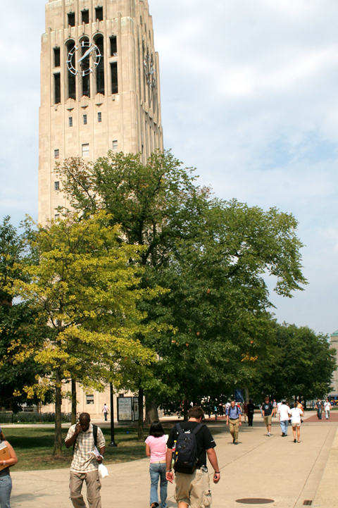

Your Company
Schools & Universities

Slide 2


[Your Company] can help you…
[Your Company]
Alert and inform students and parents
Keep everyone up-to-date
Celebrate school spirit
Keep alumni involved

Slide 3



Alert and Inform Students and Parents
“Please be advised. The University library will be open from 7:00 AM to 11:00 PM during finals week. Take advantage of the extended hours. Good luck, Lions!”
APPOINTMENT REMINDERS
SMS TEXTS
VOICE BROADCASTS
  Immediately deliver urgent alerts and announcements
  Ensure critical tasks are completed on time
  Include alerts for those who prefer landline calls over text
Notes:
Instantly inform students, parents, and faculty!
SMS Texts
K-12: Alert parents of last-minute “snow day” school closures, notify parents of student safety during/after natural disasters and urgent matters, inform parents of important school events, upcoming progress reports, and gas leaks
Universities: Alert students of last-minute class cancellations, Inform students of extended library hours during midterms & finals, Notify students of new facilities/programs/classes
Ex. “Please be advised. The University library will be open from 7:00 AM to 11:00 PM during finals week. Take advantage of the extended hours. Good luck, Lions!”
Appointment Reminders
K-12: Remind parents to:
sign important forms and permission slips
attend upcoming PTA meetings and Parent-Teacher conferences
pick up kids early on “Minimum Days” or short school days
Universities:
Send students friendly reminders to:
Pay tuition on time
Ex. “Attention students: late tuition payments are due on September 15. Please make your payments at Thompson Hall. Thank you”
Study hard during midterms/finals
Attend school sports games
Remind faculty to:
Attend department meetings
Attend school sports games
Hand out evaluation forms at the end of the quarter/semester
Voice Broadcasts
Announce last-minute event or program changes with a direct and effective voice messaging.

Slide 4


Keep Everyone Up-to-Date
Don’t forget to attend our first CIF volleyball match at Larkin High School @5:00PM! See you all there!
E-NEWSLETTERS
SMS TEXTS
FACEBOOK AND TWITTER POSTS
  Boost awareness for on- and off-campus activities
  Increase attendance for campus events and assemblies
  Broadcast news events and highlights
Notes:
E-Newsletters
K-12: Notify parents of item suggestions for emergency food packs, announce exciting academic progress and achievements, send event schedule for the entire school year, inform parents about new programs and after-school clubs, field trips
Universities: Inform students of all available academic resources, announce campus highlights and recognitions, notify students of new amenities and facilities
SMS Texts
Remind students of on campus events, sports competitions, and assemblies
Notify faculty of meetings
Remind parents of events, chaperon shifts, and school field trips
Ex. “Don’t forget to attend our first CIF volleyball match at Larkin High School @5:00PM! See you all there!”
Social Media
Post class pictures, students of the month, sports game wins, important updates, school announcements, campus renovations and school achievements, school performances, Associated Student Body (ASB) events, Prom & Homecoming pictures
Ex. “Congratulations to this year’s Prom King and Queen – Jane Huckleberry and Matt Harvey!” + Picture

Slide 5



Celebrate School Spirit
Text GEAR to 96362 for a chance to win a Grove High School sweater at the next pep rally!
ONLINE SIGN-UP PAGES
  Students can easily sign up for clubs and committees
  MOBILE KEYWORD
  Encourage students to join sports programs and clubs
  MOBILE VOTING
    Get immediate feedback about trending topics
  TEXT-TO -SCREEN
    Boost participation and engagement during live school events
Notes:
OSPs
Easily set up online sign-up forms to organize teams and committees
Make it easy for volunteers to sign up for school events
Make it easy for those to sign up for clubs and special events
Alumni can register their names, mobile numbers, email, and other custom data to stay in the loop
Mobile Keyword
Invite students at pep rallies and assemblies to text in the keyword for a chance to win school gear or gift cards
Encourage students to join clubs, sports teams, and other school organizations
Post the keyword on campus bulletin boards, banners, in bookstores, classrooms, and libraries
Ex. “Text GEAR to 96362 for a chance to win a Grove High School sweater at the next pep rally!”
Mobile Voting
Students can participate in entertaining quizzes or partake in voting during assemblies to give immediate feedback!
Find out more about what parents and students want so you can improve your school’s offerings!
Ex. “Which International Week performance did you like the best? 1) Traditional drum circle 2) Cultural history play 3) Polynesian dance”
Text-to-Screen
Engaging way for students and teachers alike to text questions and comments to a public display screen for all to see
Perfect for sporting events, assemblies, school dances, campus seminars, and more!

Slide 6

Keep Alumni Involved
Attention Trojan Alumni: We will be posting a job fair on August 12 from 1-5PM. If you’d like to participate or reserve a booth, please give our Alumni Office a call at 888-xxx-xxxx
“The 10 year c/o 2002 Reunion was a huge success! Thanks to everyone who came out
EMAIL COMMUNICATIONS
  Encourage donations and help to current students
  SMS TEXTS
    Send text alerts for job fairs and networking events
  MMS MESSAGES
  Boost attendance to events with enticing photos
  SOCIAL MEDIA
  Inform alumni of university updates and alumni associations
Notes:
Active alumni can translate into donations, opportunities for current students, and positive promotion of your school name.
Email Communications
Inform interested alumni on new programs, events, and donation opportunities
Invite successful alumni back to speak at panels and forums
Encourage alumni to offer job opportunities for graduating students
SMS Texts
Send information on upcoming job fairs and networking events
Ex. “Attention Trojan Alumni: We will be posting a job fair on August 12 from 1-5PM. If you’d like to participate or reserve a booth, please give our Alumni Office a call at 888-945-0089.”
MMS Messages
Attract alumni to reunions and other meaningful alumni affairs
Ex. “The 10 year c/o 2002 Reunion was a huge success! Thanks to everyone who came out.” + pic
Social Media
Post pictures and articles of university events and featured stories

Slide 7

Why [Your Company]?
Mobile Text, Email, Voice, Chat, and Social Media
– on a SINGLE platform for one low price
  5 channels cover more customers than email or texting alone
  No need to learn multiple software or pay multiple bills!
  Latest digital technologies to effectively communicate with the entire student body and faculty

Slide 8

[ Insert Benefits of Your Company ]
(EXAMPLES):
7-Day technical Support
Complimentary training session
Low price for plans
Rollover text credits
NO contract
[Customize to reflect Your Company’s Free Trial availability and sales phone number]
Sign up NOW for a Free Trial, or Call us today at [phone number] to see why so many Schools & Universities choose us for all of their messaging needs!

