Slide 1


Your Company
Retail
Industry

Slide 2


[Your Company] can help you…
[Your Company]
Reel in more first-time shoppers
Boost repeat customer visits
Bring in shoppers during slow times
Keep shoppers in the loop
Build your contact database

Slide 3

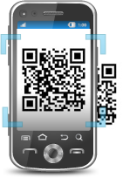

RETAIL Industry
Reel in More First-Time Shoppers
Come check out our new line of products, and enjoy 15% off your entire purchase! Just text GLAM to 96362
MOBILE KEYWORDS
SOCIAL MEDIA
QR CODES
  Entice shoppers while building your contact database
  Encourage viral marketing for increased exposure
  Direct guests to your online store with one scan
Notes:
Mobile Keyword
- Post your mobile keyword and short code on storefront signs, flyers, newspaper ads, your website, and even on receipts to entice prospective customers and keep repeat customers coming back for more
- Ex. “Come check out our new line of products, and enjoy 15% off your entire purchase! Just text GLAM to 96362”
Facebook and Twitter
– ex. “Be sure to ‘like’ and ‘share’ our exclusive sale post! Going on this week only – enjoy up to 60% off select styles! Don’t forget to tell your family and friends!”
- Reel in more shoppers by posting pictures of trendy styles and new products on Facebook and Twitter!

Slide 4


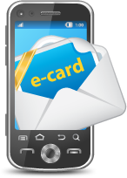
Boost Repeat Customers
MMS
MOBILE COUPONS
  Send discounts directly to shoppers’ mobile phones
  MOBILE ECARDS
    Invite customers to your exclusive sales events
  MMS TEXT MESSAGES
    Attract shoppers with the hottest new styles
Notes:
Mobile Coupons
-Traditional coupons are a pain to cut out and are often forgotten at home, which means lower redemption rates and less business.
Mobile coupons are fast, easy and convenient
- Modernize your coupons
- Brings in more shoppers which means more sales
- Send exclusive offers to have customers want to come back
- Ex. “Our BOGO sale is going on Mon-Weds until the end of summer! Present code: B1G1 to cashier upon checkout!”
Mobile eCards
- Send mobile eCards on their birthdays or special holidays with attached promos and discounts!
- Ex. “Happy birthday, Beth! Come in today to enjoy 15% off all of the new spring styles!”
MMS Texts
- Ex. “Check out our new spring dresses and accessories! Stop in today and save up to 30%!” + picture

Slide 5
Bring in Shoppers During Slow Times
Come in today from 12-3pm for an additional 20% off!
SMS TEXT BLAST
  Offer time-sensitive deals for quick responses
  FACEBOOK AND TWITTER POSTINGS
    Take advantage of the popularity of social networks
  MOBILE ECARDS
    Invite shoppers to impromptu sales events
Notes:
SMS Text Blasts
- Offer time sensitive deals to motive customers to act quickly
Ex “Come in today from 12-3pm for an additional 20% off!”
Facebook and Twitter Postings
Customers are constantly on social media, so grab their attention with posts.
Offer exclusive deals on social media
Ex. “Secret sale! All necklaces are half off when you purchase 3 or more!”
Mobile eCards
Drive in traffic within a short time period without having to plan ahead
Events can be held the same day with instantaneous marketing
Ex “Today only, buy one get one free for all v-neck t-shirts!”

Slide 6

Keep Shoppers in the Loop
Informed customers means increased sales!
SEND EMAIL NEWSLETTERS
  News on the latest trends, discounts, and other announcements
SOCIAL MEDIA UPDATES
  Post fashion tips and new arrivals to stir excitement
QR CODES
  Instantly direct shoppers to your Facebook Page, blog, or online store
Notes:
Email
- Consumers love sales and discounts!
- Be detailed with your announcements and even include pictures and printable coupons in your emails!
Social media campaigns:
- Post photos of new arrivals, store improvements, and submitted photographs of customers using or wearing your products to build positive customer relations!
- Post exclusive promotions on your Facebook and Twitter to get your followers and fans to come in!
Tweet: First 50 to come in and mention our promo code will receive a free accessory! Just mention the secret word “Accessorize” to our cashier
Facebook: First 25 Facebook Likes get a $15 gift card to our new boutique!
- Engage customers and build anticipation with a series of posts leading up to a major sale
QR codes
Place your QR code anywhere to direct shoppers to any website! Direct them to your website, catalog, or social media with just one scan!

Slide 7
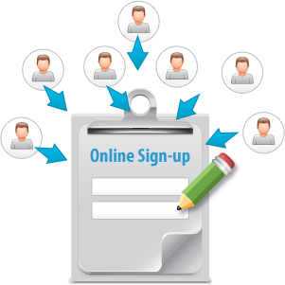

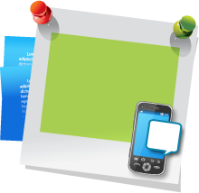
Build Your Contact Database
SNEAKER to 96362
  and join our VIP list
KEYWORDS & SHORT CODE
  Fun way to quickly collect mobile numbers
ONLINE SIGNUP PAGE(OSPS)
  Collect detailed customer data to gain valuable insight
FACEBOOK WIDGETS
  Fans can sign up for news and promotions right on your Facebook Page
Notes:
Keywords and Short Codes
-Advertise your keywords on storefront signs, flyers, and on your website offering exclusive deal vouchers and text-to-win contests!
- Ex. Text SNEAKER to 96362 and join our VIP list to find out the release dates of our newest lines and receive exclusive deals!
OSPs
-You can collect custom data with OSPs like gender, age range, favorite color, etc.
- Ex. Send customers specific promotions to those contacts who filled out their favorite apparel pieces while filling out your OSP.
Facebook Widgets
- Ex. Status update: “Hi Everyone! Make sure you fill out our widget to the left to receive exclusive deals and offers!”

Slide 8

Why [Your Company]?
Mobile Text, Email, Voice, Chat, and Social Media
– on a SINGLE platform for one low price
  5 channels cover more customers than email or texting alone
  No need to learn multiple software or pay multiple bills!
  Latest digital technologies to create loyal shoppers

Slide 9

[ Insert Benefits of Your Company ]
(EXAMPLES):
7-Day technical Support
Complimentary training session
Low price for plans
Rollover text credits
NO contract
[Customize to reflect Your Company’s Free Trial availability and sales phone number]
Sign up NOW for a Free Trial, or Call us today at [phone number] to see why so many Retail businesses choose us for all of their marketing needs!

