Slide 1
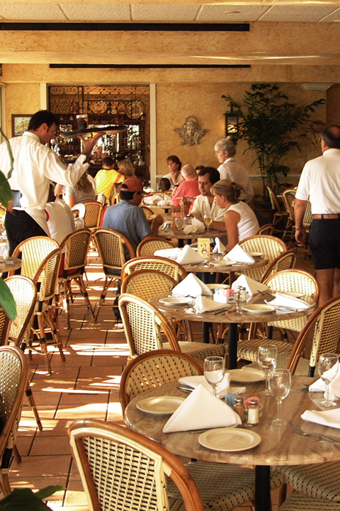

Your Company
Restaurant
Industry

Slide 2
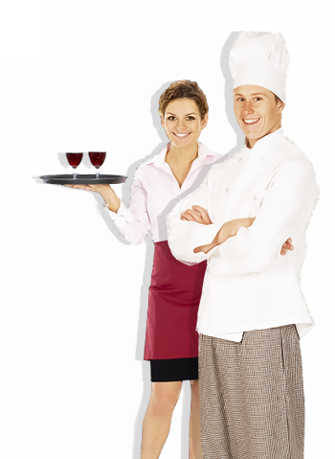

[Your Company] can help you…
[Your Company]
Attract first time diners
Bring in more repeat business
Make all hours peak hours
Minimize missed reservations
Automatically collect guest contact information

Slide 3

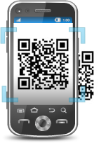

Attract First Time Diners
Text TASTY to 96362 to get 15% OFF any appetizer or dessert today!
MOBILE KEYWORD
SOCIAL MEDIA
QR CODES
  Entice customers while collecting mobile numbers
  Boost visibility with Facebook and Twitter
  Direct guests to your online menu with one quick snap
Notes:
Mobile Keyword
- Offer can’t-miss opportunities to entice new guests to dine at your restaurant
- Post these promotional mobile keywords on storefront signs, flyers, newspaper ads, and your website to drive the most traffic possible
- Ex. Text “TASTY” to “96362” to get 15% off your entire meal today!
Social Media
-Post pictures of delectable menu items with promotional messages to Facebook and Twitter
-Post messages that encourage followers and fans to “like,” “share,” or “retweet” your posts to increase visibility
QR Codes
-Print QR codes on to-go boxes, newspaper ads, and flyers to direct guests to your online menu or even your take out order webpage

Slide 4
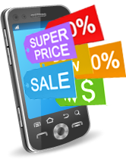
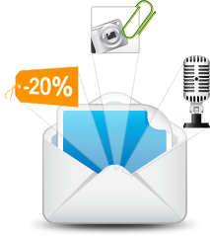
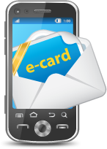
Bring in More Repeat Business
MOBILE COUPONS
  Offer instantly redeemable deals to diners
  EMAIL NEWSLETTERS
    Spark enthusiasm with featured restaurant highlights
  MOBILE ECARDS
    Build relationships by sending promotional eCards on special occasions
Notes:
Mobile Coupons
-Offer exclusive deals and promos with mobile coupons to reel customers back in.
Ex. “Be sure to stop in this week to get 15% off your entire meal! Your promo code is 1234. Show to Cashier to redeem!”
Email Newsletters
-Send email newsletters that highlight delectable new menu items, upcoming events, and important announcements
Mobile eCards
-Send guests mobile eCards on their birthdays or special holidays with attached discounts
Ex. “Happy birthday, Doug! Come by tonight with your family or friends to enjoy 50% off all appetizers as our gift to you!”
-electronic birthday and holiday cards deliver immediate sentiment

Slide 5
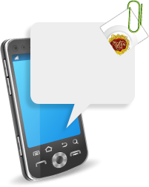
Make All Hours Peak Hours
Our summer menu is back! Come by and get a taste of our chef’s seasonal creations!
Available for a limited time, our Pasta Bolognese! Come in and enjoy it today!
SMS TEXT BLAST
  Instantly alert diners of restaurant specials, new dishes, and discounts!
  MMS(Picture) Blast
    Send tantalizing pictures with MMS
Notes:
SMS Texts Blasts
- Ex. “Our seasonal menu is back! Come by and get a taste of our chef’s latest creations!”
MMS Pictures
- Ex. “Back by popular demand, the Pasta Bolognese! Only for a limited time, don’t miss your chance.” + Picture
Mobile coupons
- Use mobile coupons to bring in more diners during slower times as well
- Deliver time sensitive promotions to bring in immediate traffic!
- Ex. “2-for-1 dinner from Mon-Wed this week! Present code HUNGRY to your server!”
-Also, reach customers through their preferred channels of communication. This will increase responses and boost traffic further

Slide 6

Minimize Missed Reservations
    Hi Peter, you have a reservation tonight at 7:00pm for a party of 2. Please give us a ring for any rescheduling or cancellation. See you soon!
Appointment Text Reminder
  Easily remind guests to show up and keep your tables filled!
Notes:
SMS Appointment Reminder
- Reduce “no-shows” as missed reservations means lost opportunity
- You can schedule these reminders for any time (whether it be hours, days, or even weeks in advance)
- If they can’t make their reservation, guests can simply text in a reply to cancel, freeing up tables for more business
Ex. “Hi Peter, you have a reservation at 7:00pm for a party of 2. Please give us a ring for any rescheduling or cancellation. Thank you!

Slide 7
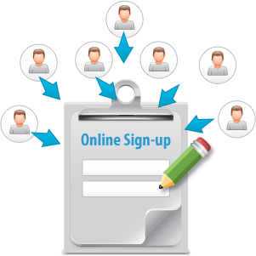
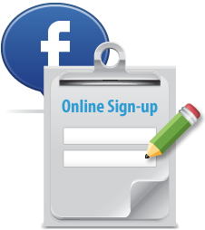
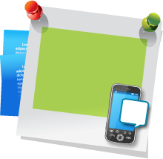
Automatically Collect Contacts
FUSION to 96362
  and join our VIP list
KEYWORDS & SHORT CODE
  Fast and easy way to capture mobile numbers
ONLINE SIGN-UP PAGE(OSPS)
  Customizable forms for customer subscriptions
FACEBOOK WIDGETS
  Anyone can sign up for news and promotions right on your Facebook Page
Notes:
Mobile Keywords and Short Code
Advertise your keywords on storefront signs, flyers, menus, and even on receipts offering exclusive deal vouchers and text-to-win contests!
Ex. Text “Fusion” to “96362” for a chance to win a $100 gift card!
OSPs
Ex. Welcome to Dine Fusion! Subscribe to our VIP List to receive EXCLUSIVE specials from us!
Facebook Widget
Ex. Status update: “Hi Everyone! Make sure you fill out our widget to the left to receive exclusive deals and offers on your mobile phones!”
Other ways to collect contacts through keyword use are:
-conducting mobile votes/polls
-using mobile coupons

Slide 8
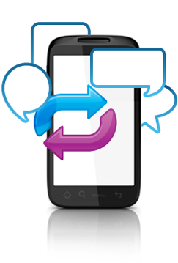
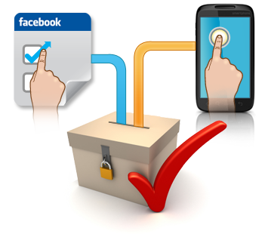
Gain Valuable Feedback
MUTI-CHANNEL VOTING
  Identify customer favorites through Facebook and mobile text!
  TWO-WAY TEXTING
    Open up communication to improve service and experience
Notes:
Multi-channel Voting
-Ex. “What would you like to see on the menu?
Text (1) buffalo wings (2) fried shrimp (3) cheesy potato skins
Or vote on Facebook!
Two-way Texting
“Tell us how we can better serve you! Text BETTER followed by your suggestion to 96362!”

Slide 9
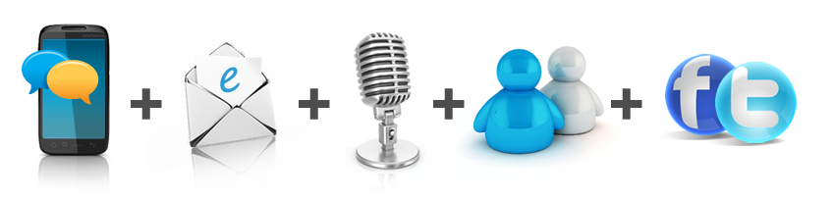
Why [Your Company]?
Mobile Text, Email, Voice, Chat, and Social Media
– on a SINGLE platform for one low price
  5 channels cover more customers than email or texting alone
  No need to learn multiple software or pay multiple bills!
  Latest digital technologies to keep tables filled and customers happy

Slide 10

[ Insert Benefits of Your Company ]
(EXAMPLES):
7-Day technical Support
Complimentary training session
Low price for plans
Rollover text credits
NO contract
[Customize to reflect Your Company’s Free Trial availability and sales phone number]
Sign up NOW for a Free Trial, or Call us today at [phone number] to see why so many Restaurants choose us for all of their marketing needs!

