Slide 1


Your Company
Real Estate

Slide 2

[Your Company] can help you…
[Your Company]
Reach new prospects more effectively
Provide instant information and updates
Sell more homes

Slide 3

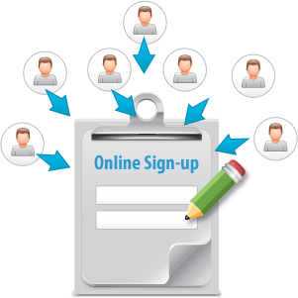
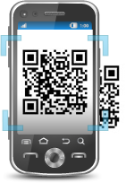
Reach New Prospects More Effectively
Text HOMES to 96362 to get exclusive updates on homes in your area!
Mobile Keyword
Online Sign-up Page
QR Codes
Attract interested buyers by posting mobile keywords on property signage and flyers
Capture contact info from prospects using easy online forms, mobile devices, or via Facebook
Engage interested buyers and instantly send property information
Notes:
Mobile Keyword
- Post your mobile keyword and short code in newspaper ads, property listings, property signage, flyers, and various other print and digital collateral to generate as many leads as possible.
Ex: "Text HOMES to 96362 to start receiving exclusive updates on new homes in your area!“
Online Sign-up Page OSP
- Easily capture contact information from interested home buyers - Embed an OSP in your existing webpage, send a link to your mOSP (mobile OSP) as an auto-response for a keyword so home buyers can sign up using their phones or tablets, or create a sign-up page on Facebook.
QR Codes
- Set up a QR Code to redirect clients to property listings
- Great way to engage clients and give them on-demand information

Slide 4



Provide Instant Information and Updates
Check out the beautiful new floors and come see the rest of what could be your new home this Friday at 2PM!
MMS
Send prospects beautiful pictures or short video tours of new homes for sale right to their mobile phones
Email Newsletter
Provide details (you can add pictures or videos) of recent property listings, neighborhood information, and even school district reviews
Social Media
Broadcast available listings and open houses, and gain a social following of interested buyers
Notes:
MMS
- Say more with pictures and videos
- Entice prospective buyers with pictures of home exteriors/interiors, or even short video clips of the homes for sale
- Ex: "Come by the Open House this Saturday from 9am-4pm! You won't want to miss this beauty!"
Email Newsletter
- Since emails have no character limit, you can be as detailed as you want with home descriptions
- Include square footage, bedroom/bathroom counts, furnishings, kitchen specs, and of course, photos!
- You can even direct prospects to your Facebook or Twitter pages with a link in your email so they can start following your listings
Social Media
- Leverage the popularity of Facebook and Twitter by posting listings as updates.
- Include pictures, open house schedules, detailed descriptions, and prices

Slide 5


Sell More Homes
We’re extending the Open House schedule for another week! Call (xxx)-xxx-xxxx for more info!
Appointment
Reminder
Make sure clients don’t
miss property showings
and deadlines during
transactions
SMS Blast
Quickly announce new listings and open houses to interested buyers
Voice Broadcast
Add a personal touch to open house invitations and appeal to buyers who may not be as comfortable with texts or emails
Notes:
Appointment Reminder
- Don't miss out another opportunity to showcase your properties.
- Send an instant text reminder so clients show up to appointments and meetings
SMS Blast
- 90% of text messages are opened.
- Announce upcoming open-houses to interested prospects in an instant
- Keep clients updated with any changes and important communications
Voice Broadcast
- Add a personal touch by recording a voice broadcast and sending it to prospective buyers
- Announce open house invitations and new listings

Slide 6

Why [Your Company]?
Mobile Text, Email, Voice, Chat, and Social Media
– on a SINGLE platform for one low price
5 channels cover more customers than email or texting alone
No need to learn multiple software or pay multiple bills!
Latest digital technologies to reach new prospects and sell more homes

Slide 7

[ Insert Benefits of Your Company ]
(EXAMPLES):
7-Day technical Support
Complimentary training session
Low price for plans
Rollover text credits
NO contract
[Customize to reflect Your Company’s Free Trial availability and sales phone number]
Sign up NOW for a Free Trial, or Call us today at [phone number] to see why so many Real Estate Agencies choose us for all of their marketing needs!

