Slide 1


Your Company
Medical
Industry

Slide 2

[Your Company]
[Your Company] can help you…
Reduce missed appointments
Keep patients informed
Gain word-of-mouth referrals
Grow patient database and manage multiple lists

Slide 3


[Your Company]
Reduce Missed Appointments
APPOINTMENT REMINDERS
VOICE BROADCAST
Eliminate no-shows with instant text reminders
Schedule text reminders hours, days, or even weeks ahead
Send personally recorded reminders to patients who may not be akin to texting
Schedule voice message reminders in advance
Notes:
Appointment Reminders - Don’t miss another opportunity to bring in sales. Drastically minimize missed appointments with SMS text reminders. - Easily schedule these reminders hours, days, even weeks in advance. - Ex. “Hi John, don’t forget! You’ve got an appointment for your annual physical tomorrow at 1pm. See you then.” Voice Broadcast - Send a voice broadcast reminder to older patients who may not be as familiar with text messaging. - A familiar voice on the other end can be more comforting for older patients.

Slide 4



[Your Company]
Keep Patients Informed
“Be sure to get your flu shots before the bug gets to you! Stop in today to get yours.”
EMAIL NEWSLETTERS
Quick and easy way to collect mobile numbers
SMS BLASTS
Send out important information to patients
FACEBOOK & TWITTER Stay organized by managing multiple lists on one database
Notes:
Email Newsletters - Include detailed information about latest services, specialist referral listings, and encourage all patients to get their annual exams. - Highlight medical articles and provide informative insights on health-related topics. SMS Blasts - Send text messages to entire distribution lists, offering preventative care tips, healthy diet tips, and more. - Ex. “Be sure to get your flu shots before the bug gets to you! Stop in today to get yours.” Facebook & Twitter - Social media is a great tool to gain visibility in the online community. - Post links of health-related articles. - Announce special events like blood drives, discounted immunizations, and more.

Slide 5
[Your Company]
Gain Word-of-Mouth Referrals
FACEBOOK & TWITTER
Post patient testimonials/reviews
Post pictures of medical office events and staff achievements & recognition
EMAIL COMMUNICATIONS Encourage patients to forward your email newsletters to friends and family
Notes:
Facebook & Twitter - Spark word-of-mouth marketing, and in turn, acquire new customers. - Post pictures of smiling patients and publish patient testimonials. Email Communications - Easily gain referrals through patients' networks by having patients forward your emails to their friends and family members. - Offer patients who refer new clients discounts on services (if applicable).

Slide 6
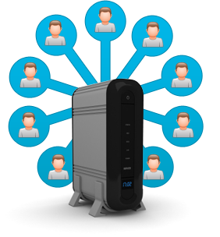
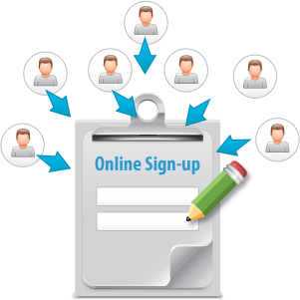
[Your Company]
Grow Patient Database and Manage Multiple Contact Lists
Text WELLNESS to 96362 to start receiving important updates from Dr. Jay
KEYWORD & SHORT CODE
Quick and easy way to collect mobile numbers
ONLINE SIGN-UP PAGES
Online subscription form
Collect online or through mobile phone
ONE DATABASE
Stay organized by managing multiple lists on one database
Notes:
Keyword & Short Code - Post your keyword and short code in the lobby, at the reception window, and on your website. - Ex. “Text WELLNESS to 96362 to start receiving important updates from Dr. Jay.” Online Sign-up Page - Embed an online sign-up page on your website or Facebook page so online visitors can easily sign up to begin receiving newsletters and announcements.
- You can collect contact information online or through mobile phones. One Database - Keep all of your contacts and multiple distribution lists organized in a single database. - Segment women and men/young and elderly for specific announcements.

Slide 7
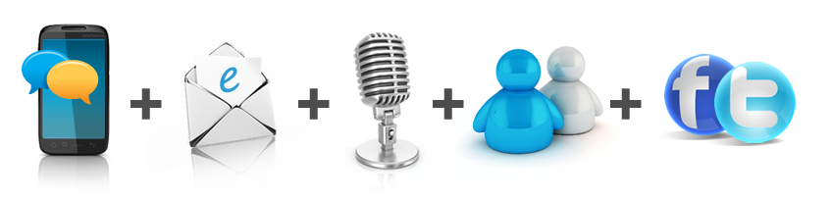
[Your Company]
Why [Your Company]?
Mobile Text, Email, Voice Broadcast, Chat, and Social Media on a SINGLE platform for one low price
5 Channels cover more customers than email or texting alone
No need to learn multiple software or pay multiple bills!
Latest digital technologies to keep patients informed and gain word-of-mouth referrals

Slide 8

[ Insert Benefits of Your Company ]
(EXAMPLES):
7-Day technical Support
Complimentary training session
Low price for plans
Rollover text credits
NO contract
[Customize to reflect Your Company’s Free Trial availability and sales phone number]
Sign up NOW for a Free Trial, or Call us today at [phone number] to see why so many Medical Practices choose us for all of their messaging and marketing needs!

