Slide 1


Your Company
Marketing
Agencies

Slide 2

[Your Company] can help you…
[Your Company]
Create, manage, and measure digital campaigns
Engage your audience with both inbound and outbound marketing strategies
Collect valuable custom data to send targeted messages
Retain clients and keep them happy with a one-stop-shop solution

Slide 3
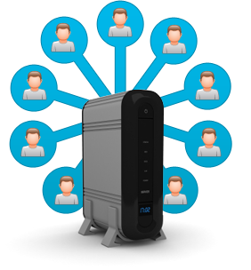

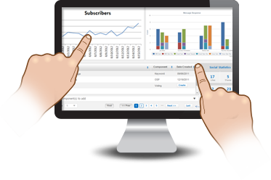
Create, Manage, and Measure Campaigns
Don’t forget to attend our blowout sale this Friday only! Doors open at 7 AM. See you there!
Collect Contacts
Send Messages
Campaign Manager
  Multiple ways to collect contacts to quickly grow your client’s database and collect targeted data
  Appeal to consumer preferences and expand your reach with 5 of today’s most popular communication channels
  Get analytics on opt-in rates, open rates, delivery reports, and social media statistics
Notes:
Collect Contacts
- Various ways to collect customers' contact information including:
- Online sign-up pages
- Mobile online sign-up pages
- Mobile Keywords + Keyword Features (Shuffle Responder, Text-to-Screen, Mobile Voting)
- Keyword Data Capture
Send Messages
-Once you have a contact database to work with, send targeted, promotional messages to customers to boost sales and start building positive customer relationships
- Send messages via SMS Text, email, chat, voice broadcast, and social media
- Multi-channel marketing hits harder than just email or texting alone.
Campaign Manager
- Track the progress of your campaigns with consolidated reports on a single page for easy viewing
- Get analytics on subscriptions, message delivery reports, message open rates, and social media stats

Slide 4
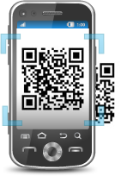


Engage Consumers with High-Impact Features
Text [COMPANY_NAME] to 96362 to start receiving exclusive news and promos!
Mobile Keyword
  Perfect tool to kick off a mobile campaign and start engaging customers
  Multi-channel Coupons
    Send immediate deals to consumers’ mobile phones or offer coupons via Facebook to drive traffic and boost sales
  QR Codes
    Interactive QR Codes give consumers on-demand delivery of important news and promotions
  Social Media
    Provide an interactive space for consumers to build online relationships with clients’ brands
Notes:
Mobile Keyword
- Great way to introduce mobile marketing campaigns to your audience
- Advertise mobile keywords through print collateral, client websites, social media, and emails to optimize subscription rates
Multi-channel Coupons
- Offer instant coupons directly onto customers' mobile phones to boost sales quickly
- Create Facebook coupons to offer exclusive deals to social audiences. (You can Like-gate these coupons to increase Likes for company Pages,
- Be sure to include details on the coupon to set restrictions and rules
QR Codes
- Fun and interactive feature that lets audience members scan a code to receive important information directly onto their mobile phones
- Redirect your audience to your website, online listings, and more!
Social Media
- Facebook and Twitter are great platforms to spark word-of-mouth marketing and have an online presence at no cost.
- Audience members can begin building social relationships with companies and brands
- Social media marketing features include Facebook Tab Editor to provide additional pages and information onto Facebook Pages, Facebook Like-gating to garner more Likes and increase visibility, and Facebook Coupons to offer exclusive deals right from companies' Facebook pages.

Slide 5

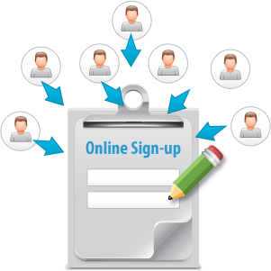
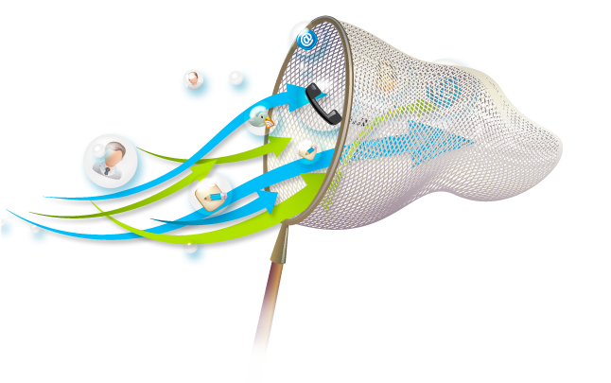
Collect Valuable Custom Data to Send Targeted Messages
Custom Data Fields
  Collect various types of data like age, gender, and income range
  Create campaigns that tailor-fit consumer demographics
  Online Sign-up Pages
    Capture customer information (including custom data) online, via mobile devices, or from Facebook
  Keyword Data Capture
    Fun and interactive way to use keyword opt-ins to collect much more than mobile numbers
Notes:
Custom Data Fields
- Ability to collect extremely important information to cater messages towards specific demographics for better targeting, better responses, and better results.
- You can collect this data or import data with a .csv file
- Examples of custom data include: Age, Gender, Income Range, Location, Favorites, and Birthday
Online Sign-up Pages
- Convenient online forms to collect consumer information
- Templates and customization is available for online sign-up pages
Keyword Data Capture
- Fun and exciting way to engage audience members and collect custom data at the same time.
- Set up auto-responses to collect multiple types of data -- so it's practically effortless

Slide 6



One-Stop-Shop Solution Attracts and Retains Clients
5 Communication Channels
Innovative Features
API Integration
  Stay ahead of the game with new mobile, email, and social media marketing features
  Integrate a robust, two-way API with your client’s application to enhance existing services
  Combines all popular channels of communication on a single platform
Notes:
5 Communication Channels
- On a single platform, you get mobile text, email, chat, voice broadcast, and social media message capabilities, and a wide array of mobile, email, and social marketing features to activate hard-hitting campaigns
Innovative Features
- Constantly developing new features and enhancements to current features and messaging services to stay ahead of the game.
API Integration
- Integrate a robust. two-way messaging API with existing services
- API is straightforward URL post
- constantly expanding API to offer more control and better integration

Slide 7
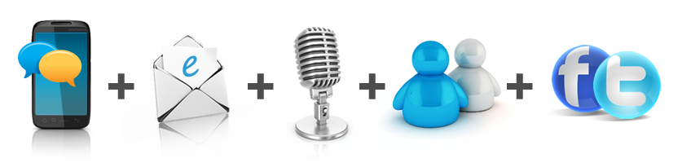
Why [Your Company]?
Mobile Text, Email, Voice, Chat, and Social Media
– on a SINGLE platform for one low price
  5 channels cover more customers than email or texting alone
  No need to learn multiple software or pay multiple bills!
  Latest digital technologies to engage consumers, launch targeted marketing campaigns, and retain more clients.

Slide 8

[ Insert Benefits of Your Company ]
(EXAMPLES):
7-Day technical Support
Complimentary training session
Low price for plans
Rollover text credits
NO contract
[Customize to reflect Your Company’s Free Trial availability and sales phone number]
Sign up NOW for a Free Trial, or Call us today at [phone number] to see why so many Marketing Agencies choose us for all of their marketing needs!

