Slide 1


Your Company
Hospitality Services
Hotels & Resorts

Slide 2
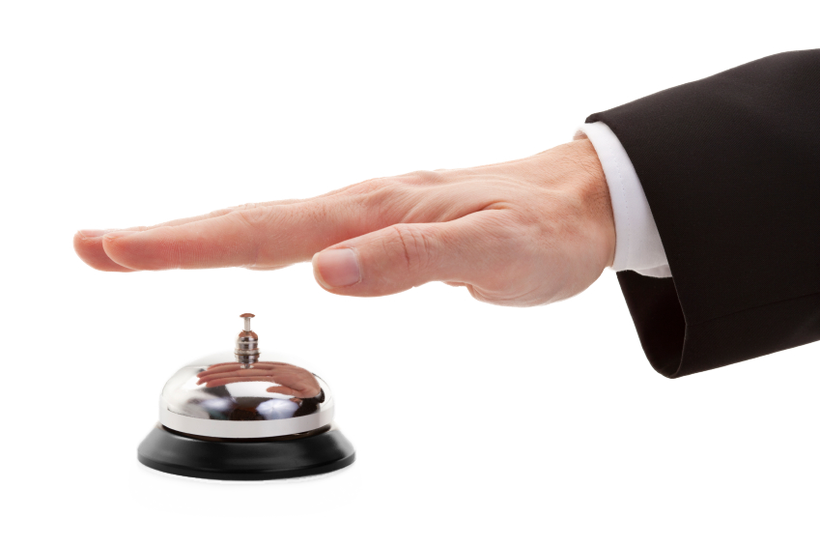
[Your Company] can help you…
[Your Company]
Attract more first-time guests
Keep guests engaged during their stay
Quickly inform and update guests
Collect guest contact information automatically

Slide 3

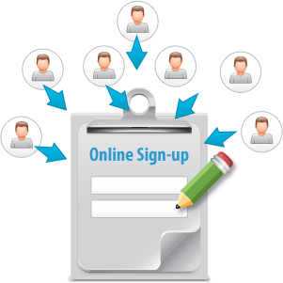

Attract More First-time Guests
Text [HOTEL_NAME] to 96362 to begin receiving exclusive offers for weekend stays!
MOBILE KEYWORD
ONLINE SIGN-UP PAGE
SOCIAL MEDIA
  Advertise your hotel or resort and raise more interest while collecting mobile numbers
  Capture contact info from interested guests using easy online forms
  Boost visibility by posting enticing updates on Facebook and Twitter
Notes:
Mobile Keyword
- Advertise mobile keywords on flyers, local ad spaces, directories, newspapers, and in your actual establishment
- Include a compelling reason for why guests should text in your keyword
- Ex: "Text [HOTEL_NAME] to 96362 to begin receiving exclusive offers for weekend stays!"
Online Sign-up Page (OSP)
- Capture guest information including first/last names, mobile numbers, email addresses, and even custom data
- Host OSPs on your own website, as a single-standing webpage, or on your Facebook Page
Social Media
- Heighten your visibility and boost word-of-mouth marketing with enticing posts on social media
- Use Facebook Like-gating and Facebook Coupons to attract a faithful following on Facebook
- Once your Page is Liked, your updates will appear on Followers' newsfeeds, making your posts that much more visible
- Include enticing information in updates to attract more guests

Slide 4



Keep Guests Engaged During Their Stay
“Not sure where to go tonight? Check out this short video tour of all the local hot spots! “ + video
FOLLOW-ON
AUTO-RESPONSES
  Delight guests with tips on available amenities, local
  hot spots, and entertainment
  MMS
    Send pictures or short video clips of affiliated attractions
  SHUFFLE RESPONDER
    Guests can receive local dining suggestions every time they text in a keyword
Notes:
Follow-on Auto-Responses
- Set up follow-on auto-responses for various keywords
- Let guests know what amenities are available in your hotel/resort/casino, hours of operation for those amenities, local attractions, and featured entertainment
MMS
- Show guests what they could be missing out on by sending a picture or short video clip of fun things to do in your hotel, casino, or resort, or even at local hot spots
Shuffle Responder
- Sometimes, room service isn't always the best option for some guests.
- Advertise your shuffle responder keyword in guests' rooms, hallways, and lobby
- Set up shuffle responders to send guests dining suggestions whenever they text in your shuffle keyword
- Include hours of operation, and even a link to restaurant reviews

Slide 5


Quickly Inform and Update Guests
Give us a call at
(xxx)-xxx-xxxx
and see if you’re eligible to upgrade to our exclusive suite!
SMS TEXT
  Inform guests about promotional offers like upgrade opportunities on discounted suites and services
  APPOINTMENT
  REMINDER
    Remind guests to check in and out on time
  VOICE BROADCAST
    Perfect for guests who may not be as akin to texting
Notes:
SMS Text
- Inform guests about upgrade opportunities when they book a stay
- You can increase revenue by offering discounted suites and services
- Be sure to include details on how to redeem
Appointment Reminder
- A simple reminder of check-in/out times is a great gesture of community service
- This will help guests feel more at ease and will reduce call traffic for the concierge
Voice Broadcast
- Announce important news or any urgent matter with a friendly voice broadcast
- Inform guests about upgrades
- Appeal to those who may not be as akin to texting

Slide 6
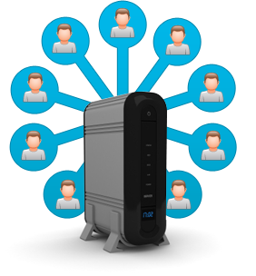

Collect Guest Contact Information Automatically
MULTIPLE METHODS
MULTI-PURPOSE OSP
ONE SECURE DATABASE
  Mobile Keyword: Grab attention with compelling auto-responses
  Shuffle Responder: Self-service for valuable offers
  Text-to-Screen: Get hotel & resort event attendees engaged
    Online Sign-up Page: makes capturing various types of contact info a breeze
    Facebook Sign-up Page: leverage the popularity of Facebook to collect valuable contact info
    Sign-up Widgets: Embed a widget to your existing webpage to easily gather contact info
    Keep various types of contact info in one secure place instead of scattering email and mobile contacts across multiple platforms
    Stay organized and manage different campaigns
Notes:
Multiple Methods
- Multiple keyword features give you multiple avenues to collect mobile numbers
- Aside from standard mobile keyword, these features also let you automatically collect mobile numbers: shuffle responder, text-to-screen, mobile voting
Multi-purpose OSP
- these online forms are the easiest way to capture guests' contact info
- you can even collect custom data to send more personalized, targeted messages for future campaigns
One Secure Database
- You won't have to worry about scattered contact information.
- Keep all of your contacts stored securely in one place for easy management and campaign creation

Slide 7

Why [Your Company]?
Mobile Text, Email, Voice, Chat, and Social Media
– on a SINGLE platform for one low price
  5 channels cover more customers than email or texting alone
  No need to learn multiple software or pay multiple bills!
  Latest digital technologies to attract new guests and turn them into lifelong visitors

Slide 8

[ Insert Benefits of Your Company ]
(EXAMPLES):
7-Day technical Support
Complimentary training session
Low price for plans
Rollover text credits
NO contract
[Customize to reflect Your Company’s Free Trial availability and sales phone number]
Sign up NOW for a Free Trial, or Call us today at [phone number] to see why so many Hotels & Resorts choose us for all of their marketing needs!

