Slide 1
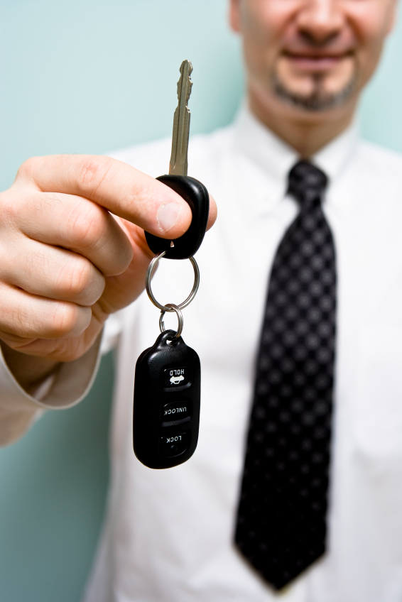

Your Company
Auto
Dealerships

Slide 2

[Your Company]
[Your Company] can help you…
Sell more cars & accessories
Announce promotions and deals
Engage new and existing customers
Build positive customer relationships
Grow your target contact database

Slide 3



[Your Company]
Sell More Cars & Accessories
To find out how to get this vehicle for only $199/mo, text CARMODEL to 96362
MOBILE KEYWORDS
SOCIAL MEDIA
MOBILE COUPONS
Interested car buyers can get more info on their favorite models with a simple text
Spark word-of-mouth marketing
Offer Facebook coupons
Motivate customers to save on car accessories and maintenance services
Notes:
Mobile Keyword - Create a mobile keyword for each car model and post the keyword and short code on car windows, flyers, newspapers ads, and even your website. Prospective customers can text in the keywords to learn about specs, prices, and more! - Ex. “To learn more about this model, text CARMODEL to 96362!” - You can also set up a mobile keyword to: - Direct customers to your online inventory of pre-owned vehicles - Direct customers to online reviews of a specific make and model - Refer buyers to similar makes and models in your lot Facebook and Twitter - Post pictures of featured vehicle models to entice new customers - Include attractive content like vehicle features (high MPG, bluetooth technology, interior trim details) - Post customer testimonials to boost credibility - Offer Facebook Coupons for maintenance services exclusively for your social audience - Feature exclusive service deals through SM (maintain positive customer relations) - Tip: social media is a great tool, but one must be actively tracking social interactions online to maintain a good relationship(s) Mobile Coupons - Send customers deals for car accessories - Offer coupons for car maintenance services like oil changes, brake checks, tire rotations, and alignments

Slide 4
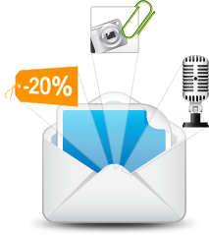

[Your Company]
Announce News & Promotions
“Shop this month only and get 0% financing for 36 months on most models!”
EMAIL NEWSLETTERS
Inform customers about monthly deals, new arrivals, and trade-in options
SMS BLASTS
Instantly announce time-sensitive deals
FACEBOOK
Public broadcasts on the most popular social network
Notes:
Email Newsletters - Provide high-impact newsletters via email about new vehicles, blowout sales, and trade-in opportunities - Hundreds of email templates available, or customize with your own HTML - Include links to your Facebook page in email newsletters to get more Like and grow your audience SMS Blasts - Bring in leads for time-sensitive deals - Ex: “Shop this month only and get 0% financing for 36 months on most models!” - Send customers instant notifications of service maintenance requirements like oil changes, brake checks, and alignments - Ex. “Hi [$First_Name], Looks like you’re due for an oil change! Come in today to get 10% off!” Facebook - Leverage the popularity of social media to announce news and promotions - Update current customers with valuable information - Encourage your audience to “share” and “like” posts to get maximum exposure. - Ex. “Share this post to tell your family and friends about our clearance sale!”

Slide 5
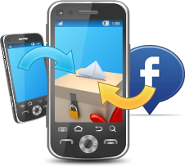

[Your Company]
Engage New & Existing Customers
MULTI-CHANNEL VOTING
Gain valuable feedback
Improve upon existing services
FACEBOOK LIKE-GATING
Attract more customers through Facebook Likes
Notes:
Multi-channel Voting - Gain valuable feedback through mobile text and Facebook on customer favorites and opinions - Use the data you collect to improve customer service and tailor marketing/sales strategies to fit the wants/needs of the customer Facebook Like-gating - Attract more people to Like you on Facebook - Create an incentive-based “before-Like” tab to entice users to Like your Page and turn your fans into customers by offering exclusive Facebook deals

Slide 6

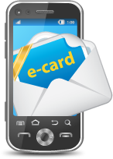
[Your Company]
Build Positive Customer Relationships
APPOINTMENT REMINDERS
Send notices of maintenance due dates and car care tips
MOBILE ECARDS
Send eCards on special occasions with attached coupons
Notes:
Appointment Reminders - Send appointment text reminders for scheduled repairs - Your customers will appreciate the reminders, and you can secure times and sales Mobile eCards - Send on birthdays, holidays, and special occasions to connect with your customers - You can even attach a mobile coupon to the eCards to offer exclusive discounts and specials

Slide 7
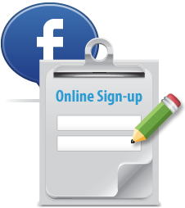
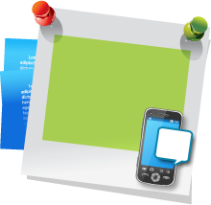
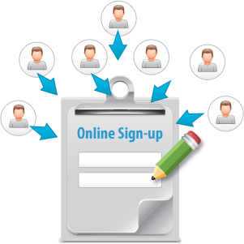
[Your Company]
Easily Grow Your Target Contact Database
NEWCAR to 99000 and join our VIP list
KEYWORD & SHORT CODE
Quick and easy way to collect mobile numbers
ONLINE SIGN-UP PAGE(OSP)
Online subscription form
Collect from PC, tablet, or through mobile phone
FACEBOOK SIGN-UP PAGE
Fans can sign up for news and deals right from your Facebook page
Notes:
Keyword & Short Code - Large collection of mobile keyword features to collect mobile numbers quickly and easily - Advertise keywords on vehicle windows, flyers, banners, on your website, etc.

Slide 8

[Your Company]
Why [Your Company]?
Mobile Text, Email, Voice Broadcast, Chat, and Social Media on a SINGLE platform for one low price
5 Channels cover more customers than email or texting alone
No need to learn multiple software or pay multiple bills!
Latest digital technologies to sell more cars and lengthen the customer lifecycle

Slide 9

[ Insert Benefits of Your Company ]
(EXAMPLES):
7-Day technical Support
Complimentary training session
Low price for plans
Rollover text credits
NO contract
[Customize to reflect Your Company’s Free Trial availability and sales phone number]
Sign up NOW for a Free Trial, or Call us today at [phone number] to see why so many Local Governments choose us for all of their messaging needs!

